Slide 1


Ticker: OTCQB – TURV
State-of-the-art Greenhouses
GROWCO, INC. – A MAJORITY OWNED SUBSIDIARY OF TWO RIVERS WATER & FARMING
DENVER, CO – INFO@TRGROWCO.COM – 303.222.1000 – OTCQB: TURV

Slide 2
COMPANY SAFE HARBOR STATEMENT
The nature of the Company’s (GrowCo, Inc. and Two Rivers Water & Farming) operations and the environment in which it operates subject it to changing economic, competitive, regulatory and technological conditions, risks and uncertainties. In connection with the “Safe Harbor” provisions of the Private Securities Legislation Reform Act of 1995, the Company notes the following factors could cause future results to differ materially from the forward looking statements, expectations and assumptions expressed or implied herein. Factors that may cause actual results to differ materially from those contemplated by such forward looking statements include, without limitation, State and Federal laws regarding marijuana, the market price for marijuana, changes in applicable statutory and regulatory requirement regarding marijuana, uncertainties in the estimation of water available under decrees, costs of the factors of production of marijuana, uncertainties in the estimation of costs of farmland development and irrigation systems, the strength and financial resources of our competitors, our ability to find and retain skilled personnel, climatic and weather conditions, labor relations, availability and cost of material and equipment, delays in anticipated permit and construction dates, environmental risks, the results of financing efforts and the ability to meet capital requirements, uncertainties related to the real estate market generally and the development of projects we currently have under contract and general economic conditions. This presentation may contain "forward-looking statements," as that term is defined in Section 27A of the United States Securities Act of 1933 and Section 21E of the Securities Exchange Act of 1934. Statements in this presentation which are not purely historical are forward-looking statements and include any statements regarding beliefs, plans, expectations or intentions regarding the future. Actual results could differ from those projected in any forward-looking statements due to numerous factors. Such factors include, among others, the inherent uncertainties associated with developing and acquiring land and water resources. These forward-looking statements are made as of the date of this presentation, and we assume no obligation to update the forward-looking statements, or to update the reasons why actual results could differ from those projected in the forward-looking statements. Although we believe that the beliefs, plans, expectations and intentions contained in this presentation are reasonable, there can be no assurance that such beliefs, plans, expectations or intentions will prove to be accurate.
GROWCO, INC. – A MAJORITY OWNED SUBSIDIARY OF TWO RIVERS WATER & FARMING
DENVER, CO – INFO@TRGROWCO.COM – 303.222.1000 – OTCQB: TURV

Slide 3
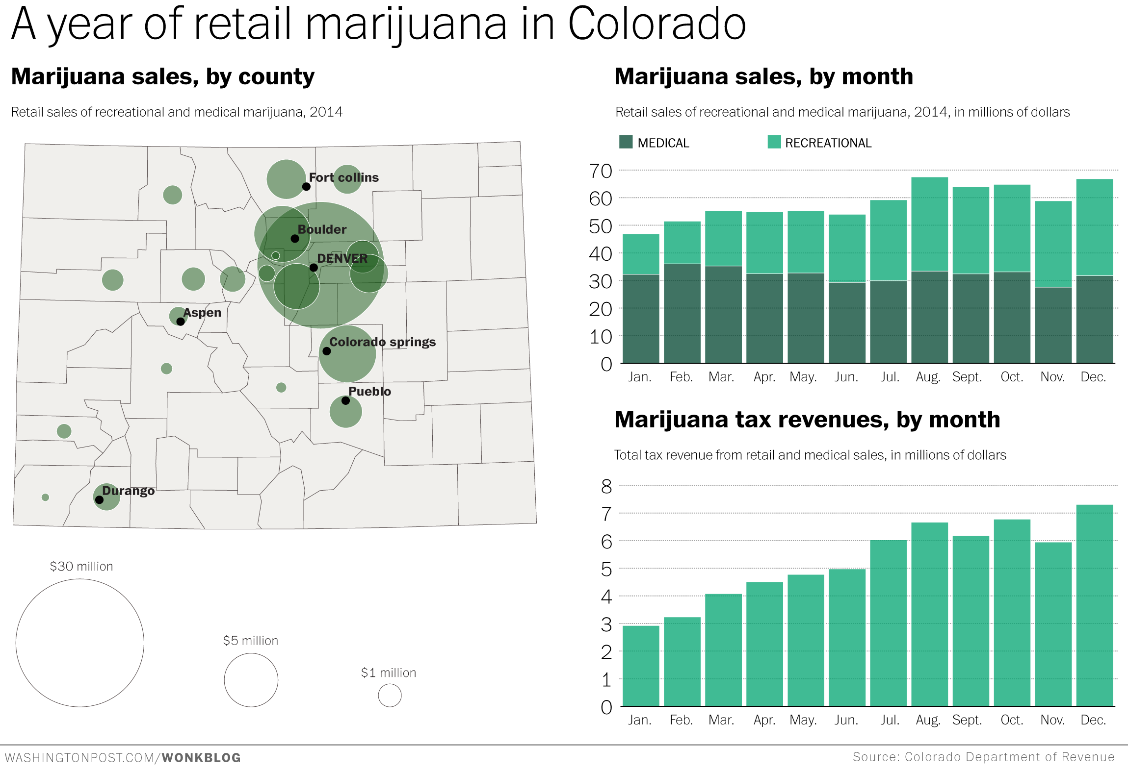
In 2016, Colorado Marijuana will be a Billion Dollar Market
*based on projected tax revenues of $94 million
GROWCO, INC. – A MAJORITY OWNED SUBSIDIARY OF TWO RIVERS WATER & FARMING
DENVER, CO – INFO@TRGROWCO.COM – 303.222.1000 – OTCQB: TURV

Slide 4
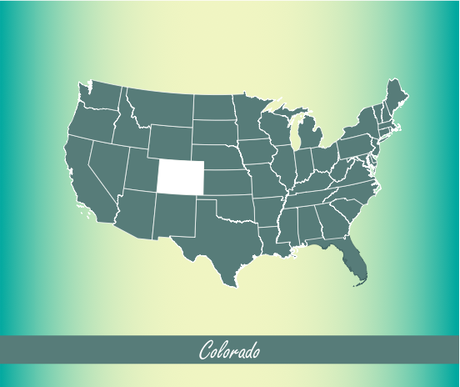
Colorado Greenhouse Opportunity
Why grow in a State-of-the-art GrowCo Greenhouse?
90% of Colorado marijuana is still grown in converted warehouses, based on legacy skill sets.
Converted warehouse grows are inefficient, disease-prone, artificial growing environments.
State-of-the-art GrowCo greenhouses are highly-efficient, natural growing systems.
GROWCO, INC. – A MAJORITY OWNED SUBSIDIARY OF TWO RIVERS WATER & FARMING
DENVER, CO – INFO@TRGROWCO.COM – 303.222.1000 – OTCQB: TURV

Slide 5

The GrowCo Advantage
200% Yield at 50% Cost
Lower Costs
Higher ROI
Better Quality
Year-Round
GROWCO, INC. – A MAJORITY OWNED SUBSIDIARY OF TWO RIVERS WATER & FARMING
DENVER, CO – INFO@TRGROWCO.COM – 303.222.1000 – OTCQB: TURV

Slide 6
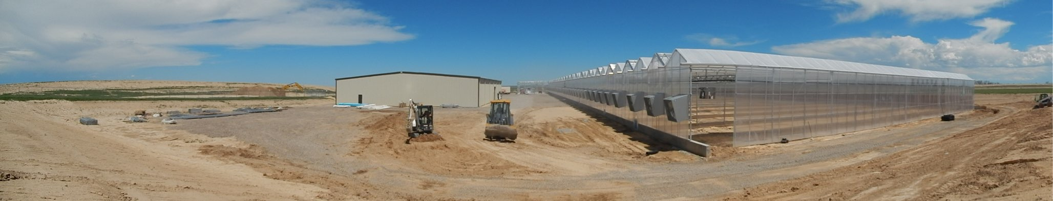
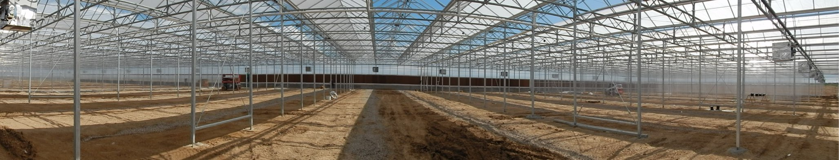
State-of-the-art Greenhouses
How big is a 2-acre greenhouse? Imagine 2 football fields.
90,000 square feet of greenhouse space can yield 10,000 pounds of marijuana per annum
GROWCO, INC. – A MAJORITY OWNED SUBSIDIARY OF TWO RIVERS WATER & FARMING
DENVER, CO – INFO@TRGROWCO.COM – 303.222.1000 – OTCQB: TURV

Slide 7
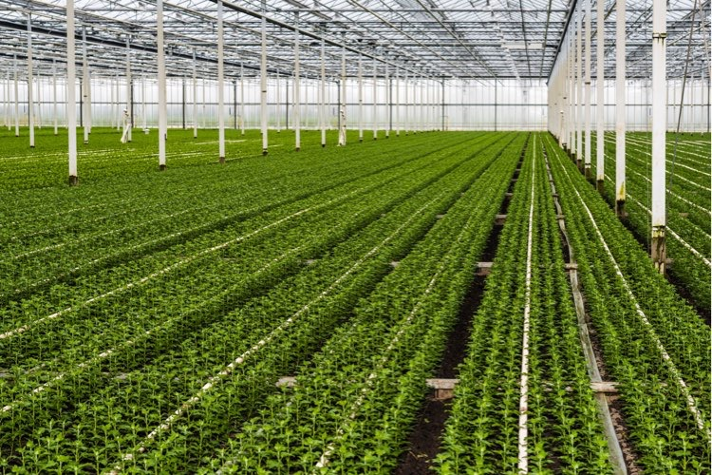

Best Practices
Efficiency
resource management
Efficiency
resource management
Quality
organic, lab-tested products
GrowCo greenhouses make the most of the sun’s natural energy, optimize water use, and maximize automation. Our approach is the best way to produce consistent product throughout the year.
Knowledge
lab-tested products
GrowCo greenhouses reduce the need for carcinogenic fungicides and other hazardous chemicals.
GROWCO, INC. – A MAJORITY OWNED SUBSIDIARY OF TWO RIVERS WATER & FARMING
DENVER, CO – INFO@TRGROWCO.COM – 303.222.1000 – OTCQB: TURV

Slide 8

Consistent Quality
GrowCo trained horticulturalists devise a specific soil mix, nutrient regimen, and growing environment for the specific strains of cannabis our tenants cultivate.
Grow Space
design & construction
Grow Space
design & construction
Agriculture
high-quality production
Chemistry
testing
Chemistry
testing
GrowCo institutes laboratory testing procedures that ensures a pure, safe, consistent product.
GROWCO, INC. – A MAJORITY OWNED SUBSIDIARY OF TWO RIVERS WATER & FARMING
DENVER, CO – INFO@TRGROWCO.COM – 303.222.1000 – OTCQB: TURV

Slide 9

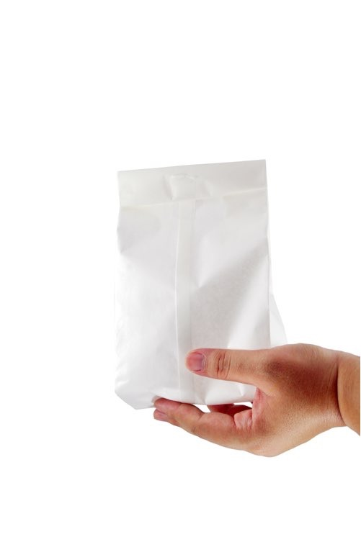
GrowCo Organizational Divisions
Greenhouse Leasing
Tenant
Services
GROWCO, INC. – A MAJORITY OWNED SUBSIDIARY OF TWO RIVERS WATER & FARMING
DENVER, CO – INFO@TRGROWCO.COM – 303.222.1000 – OTCQB: TURV

Slide 10
Greenhouse Leasing Plan
Four Greenhouses in Pueblo, CO
Construction costs at $4.5 million – Leased for $2 million per annum
Greenhouse Leasing
GROWCO, INC. – A MAJORITY OWNED SUBSIDIARY OF TWO RIVERS WATER & FARMING
DENVER, CO – INFO@TRGROWCO.COM – 303.222.1000 – OTCQB: TURV

Slide 11
Greenhouse Leasing Plan
Total Development of 1,000,000 sq. ft. by 2018
Greenhouse Leasing
pueblo, co
out-of-state projects
GROWCO, INC. – A MAJORITY OWNED SUBSIDIARY OF TWO RIVERS WATER & FARMING
DENVER, CO – INFO@TRGROWCO.COM – 303.222.1000 – OTCQB: TURV

Slide 12
GrowCo Business Development
GrowCo Business Development will provide a turnkey growing solution for licensees around the globe.
Tenant
Services
Services for Greenhouse Tenants:
Site Development
Construction & Operational Finance
Trained Master Growers and Greenhouse Managers
Cash Management & Accounting
Access to Low-Cost Crop Inputs
GROWCO, INC. – A MAJORITY OWNED SUBSIDIARY OF TWO RIVERS WATER & FARMING
DENVER, CO – INFO@TRGROWCO.COM – 303.222.1000 – OTCQB: TURV

Slide 13
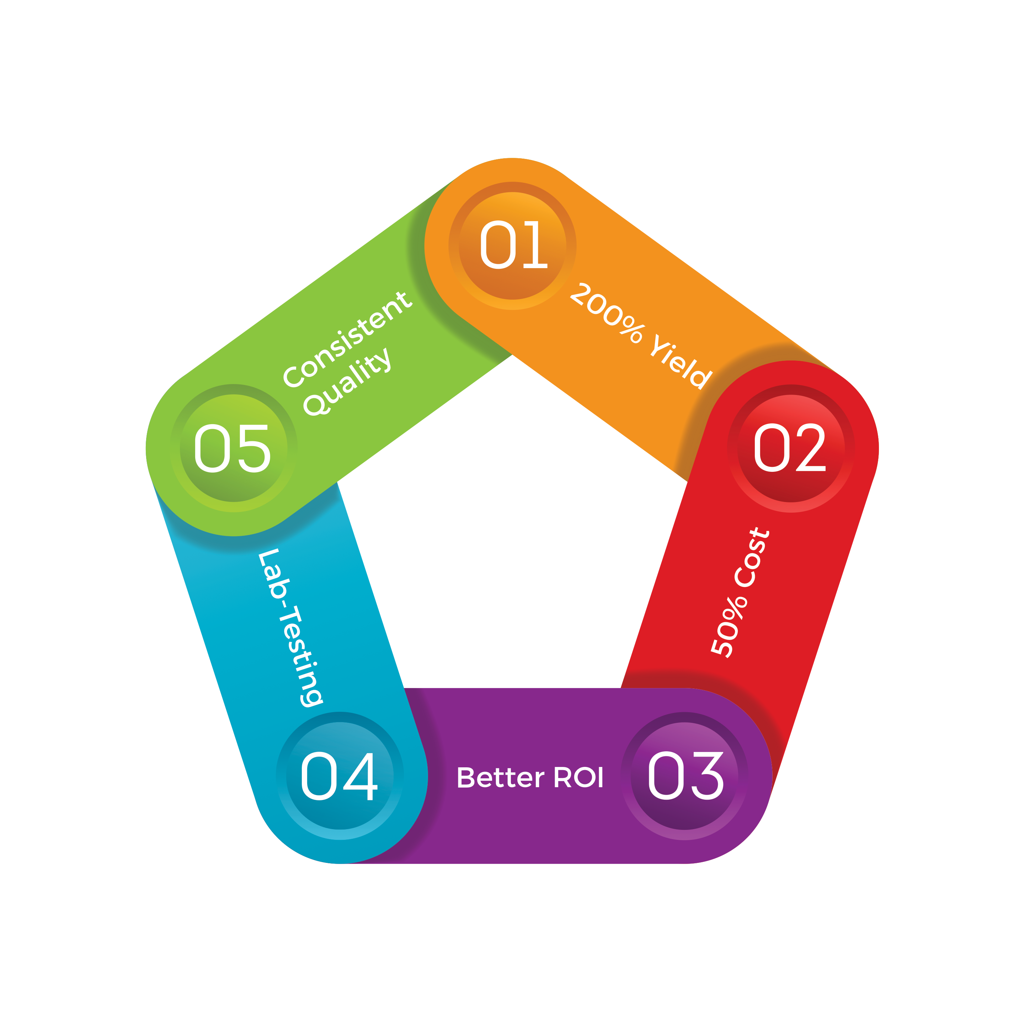
Greenhouse Value Proposition
GROWCO, INC. – A MAJORITY OWNED SUBSIDIARY OF TWO RIVERS WATER & FARMING
DENVER, CO – INFO@TRGROWCO.COM – 303.222.1000 – OTCQB: TURV

Slide 14

Investment Opportunities
Irrigated Farming
Two Rivers Water & Farming Company (OTCQB: TURV), fully reporting since 2006, owns and operates irrigated farming operations in southeastern Colorado.
GrowCo, Inc., a majority owned subsidiary of Two Rivers (TURV), provides state-of-the-art growing infrastructure and water to licensed cannabis farmers.
GrowCo does not "touch the plant". We lease our facilities to licensed growers and provide supplementary business services.
Greenhouse
Expertise
GROWCO, INC. – A MAJORITY OWNED SUBSIDIARY OF TWO RIVERS WATER & FARMING
DENVER, CO – INFO@TRGROWCO.COM – 303.222.1000 – OTCQB: TURV

Slide 15
Investment Opportunities
10 million GrowCo shares are to be distributed to holders of Two Rivers stock as of 4 record dates this year.
Distribution is approximately one GrowCo share for each 10 Two Rivers shares held on a record date. Next two record dates are July 1st, 2015 and October 1st, 2015.
Distributions will be made when GrowCo shares can be sold pursuant to an effective registration with the SEC or an exemption.
GrowCo
Dividends
GROWCO, INC. – A MAJORITY OWNED SUBSIDIARY OF TWO RIVERS WATER & FARMING
DENVER, CO – INFO@TRGROWCO.COM – 303.222.1000 – OTCQB: TURV

Slide 16
State-of-the-art Greenhouses
GROWCO, INC. – A MAJORITY OWNED SUBSIDIARY OF TWO RIVERS WATER & FARMING
DENVER, CO – INFO@TRGROWCO.COM – 303.222.1000 – OTCQB: TURV

